Slide 1
Exploratory Data Analysis on Global Terrorism dataset
By:- ADITYA RAJ

Slide 2
AGENDA
Introduction​
Problem statements
​Visualisation
​Conclusion

Slide 3
Introduction
The Global Terrorism Database (GTD) is an open-source database including information on terrorist attacks around the world from 1970 through 2017. The GTD includes systematic data on domestic as well as international terrorist incidents that have occurred during this time period and now includes more than 180,000 attacks. The database is maintained by researchers at the National Consortium for the Study of Terrorism and Responses to Terrorism (START), headquartered at the University of Maryland. Explore and analyze the data to discover key findings pertaining to terrorist activities..

Slide 4
PROBLEM STATEMENT
Most attacked country
Year wise terrorism attacks
No. of people killed by each terrorist group
Maximum number of kills on each country which exceed 200.
Percentage of kills by terrorist group
Which area and region has what amount of terrorist activity and how many number of attacks and how many number of attacks are found
Checking targets for the terrorist
Gangs involved in continious activity
10 Countries which are having most number of attacks.

Slide 6
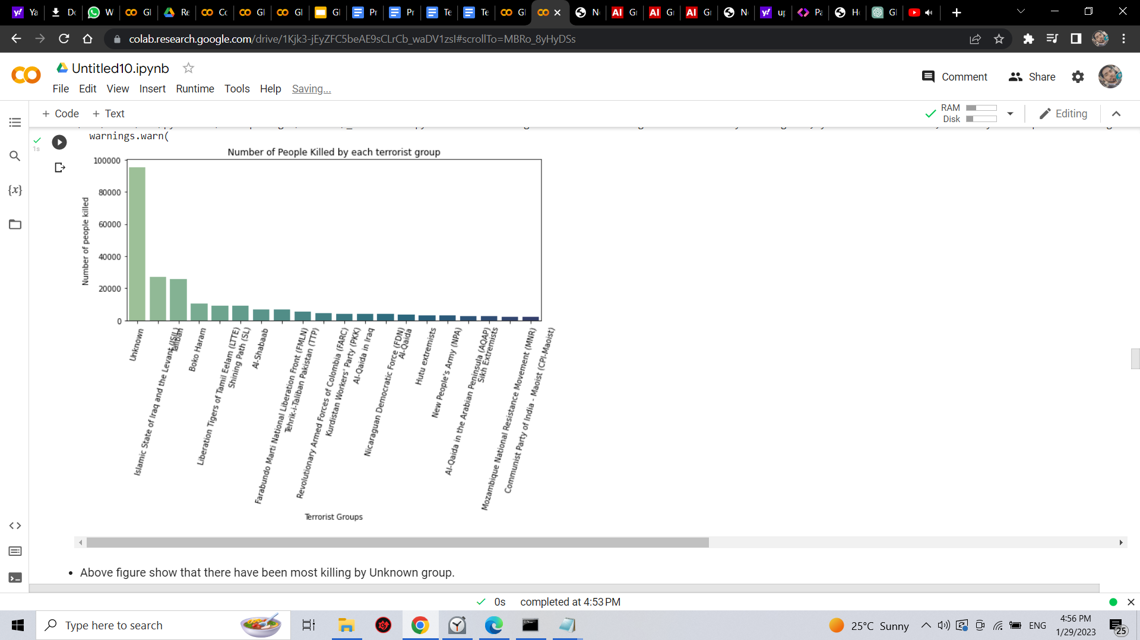
 | B2B | Supply chain | ROI | E-commerce
Q1 | 4.5 | 2.3 | 1.7 | 5.0
Q2 | 3.2 | 5.1 | 4.4 | 3.0
Q3 | 2.1 | 1.7 | 2.5 | 2.8
Q4 | 4.5 | 2.2 | 1.7 | 7.0

Slide 7
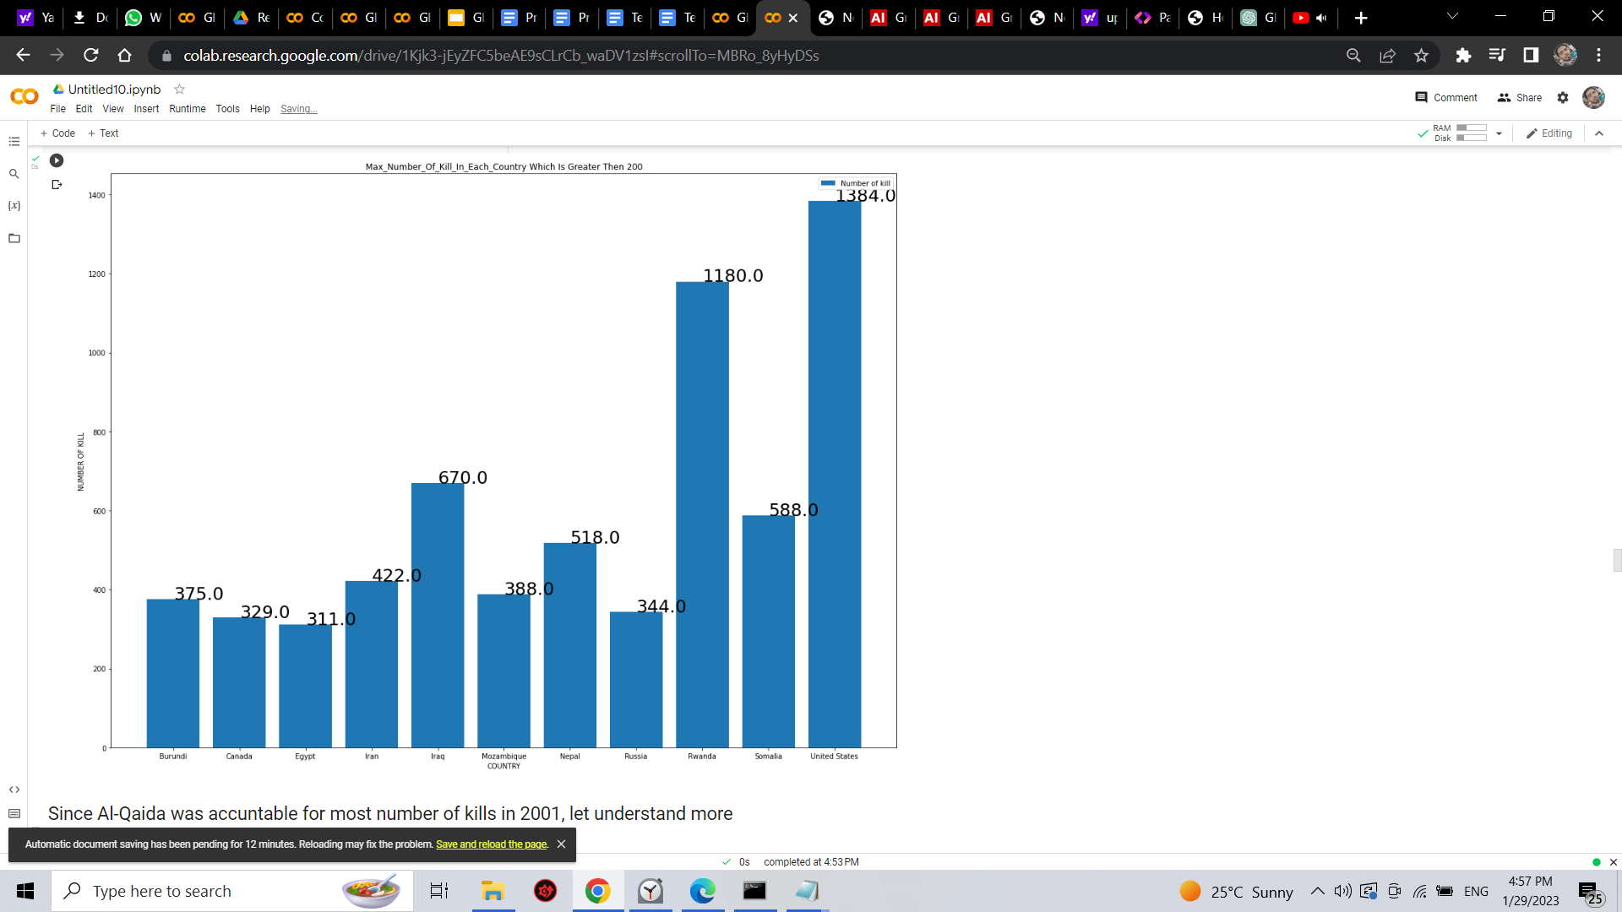
BUSINESS OPPORTUNITIES ARE LIKE BUSES. THERE'S ALWAYS ANOTHER ONE COMING.
Find the maximum number of kills in each country which exceed 200
“
”
Richard Branson

Slide 8
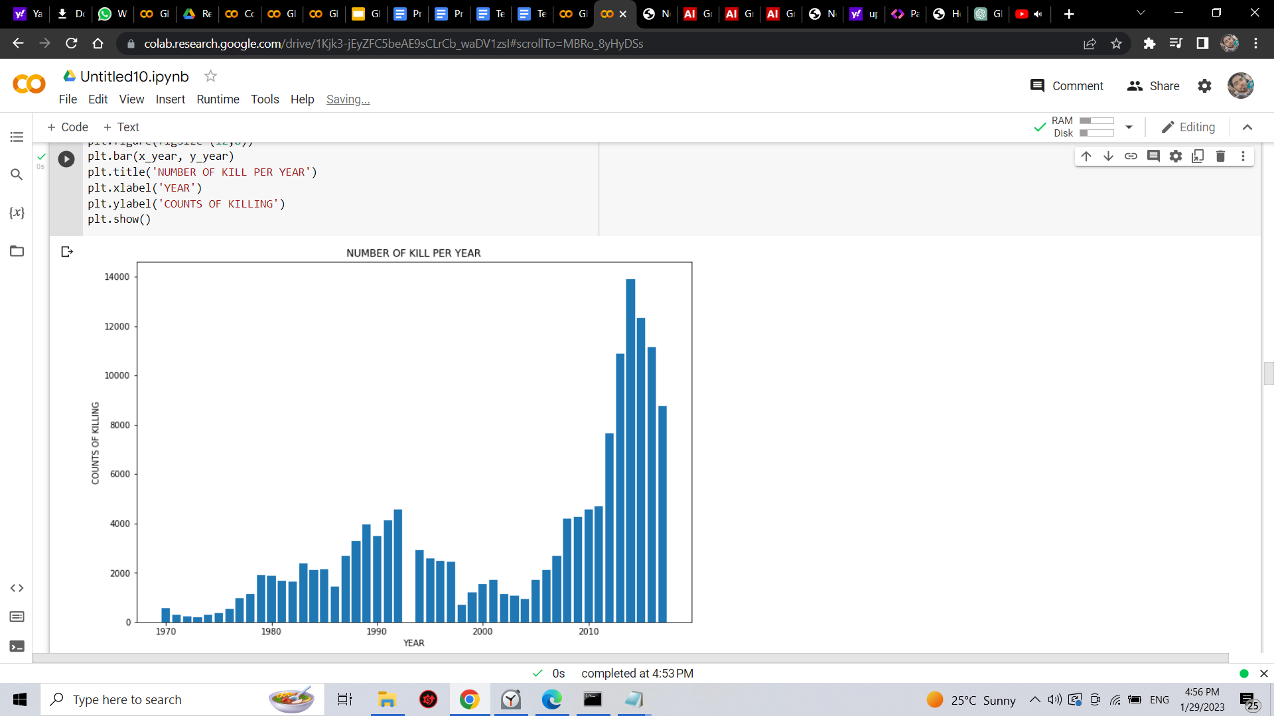
Yearwise terrorism attacks:
According to above observation,it can be concluded that number of kills increased rapidly after 2010 and where 2014 being the most deadly year having maximum number of killing.

Slide 9
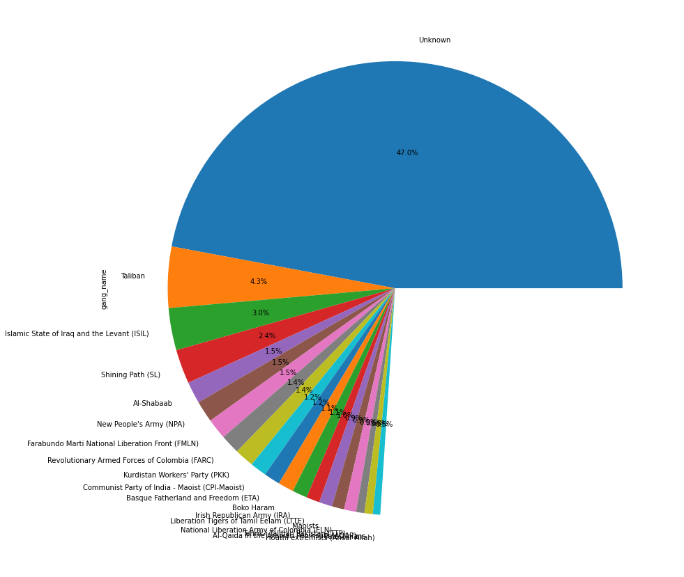
Percentage of kills by terrorist:
Taliban
ISIL
Shining path(SL)

Slide 10
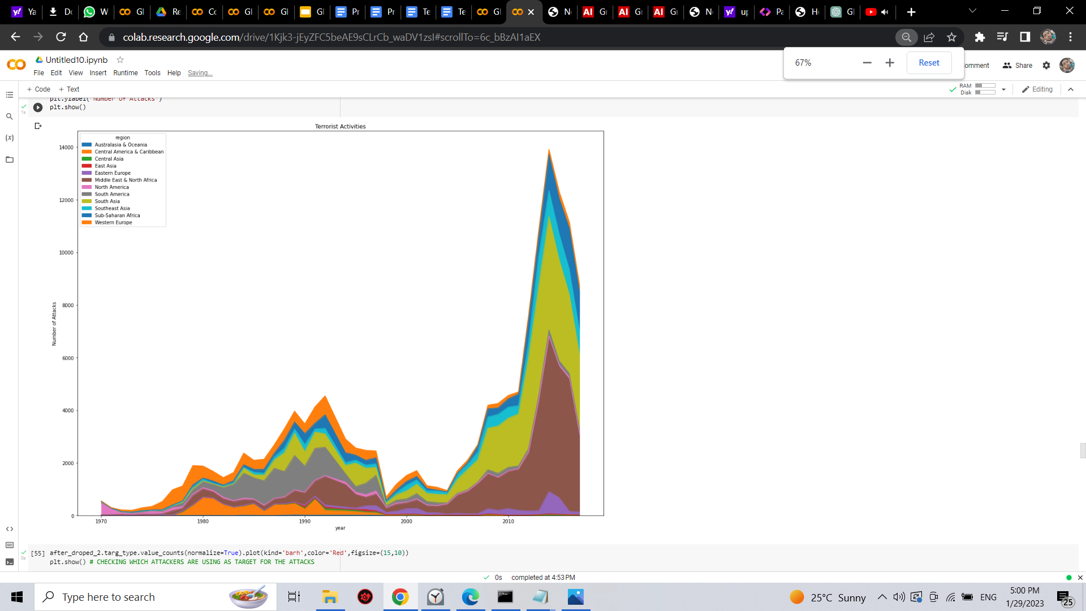
Which area and region have highest amount of attacks

Slide 11
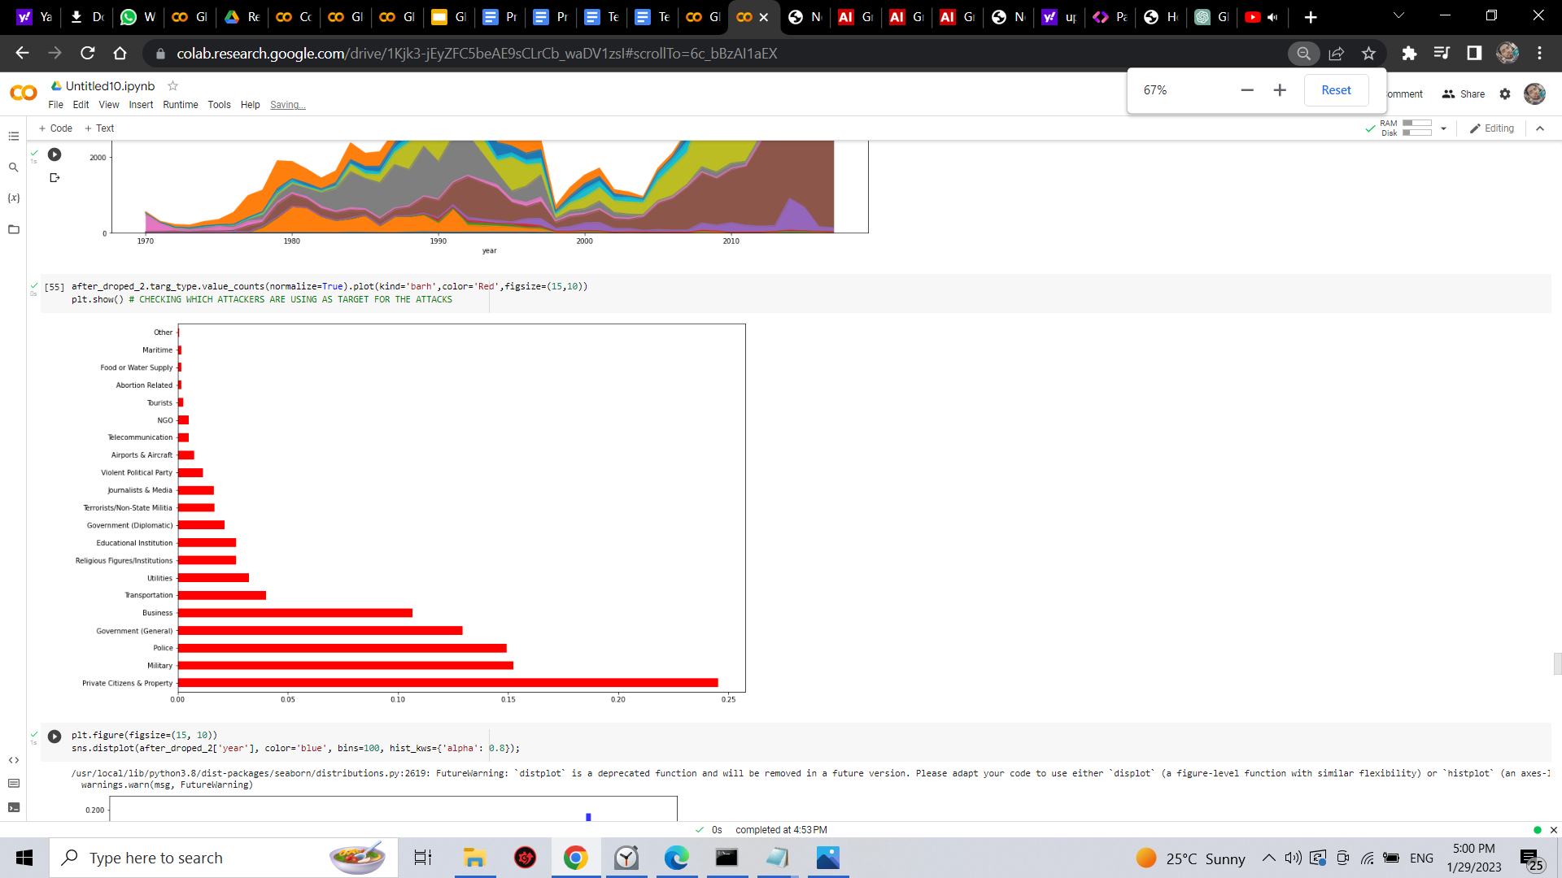
Checking target for the attacks

Slide 12

Yearwise active gangs

Slide 13
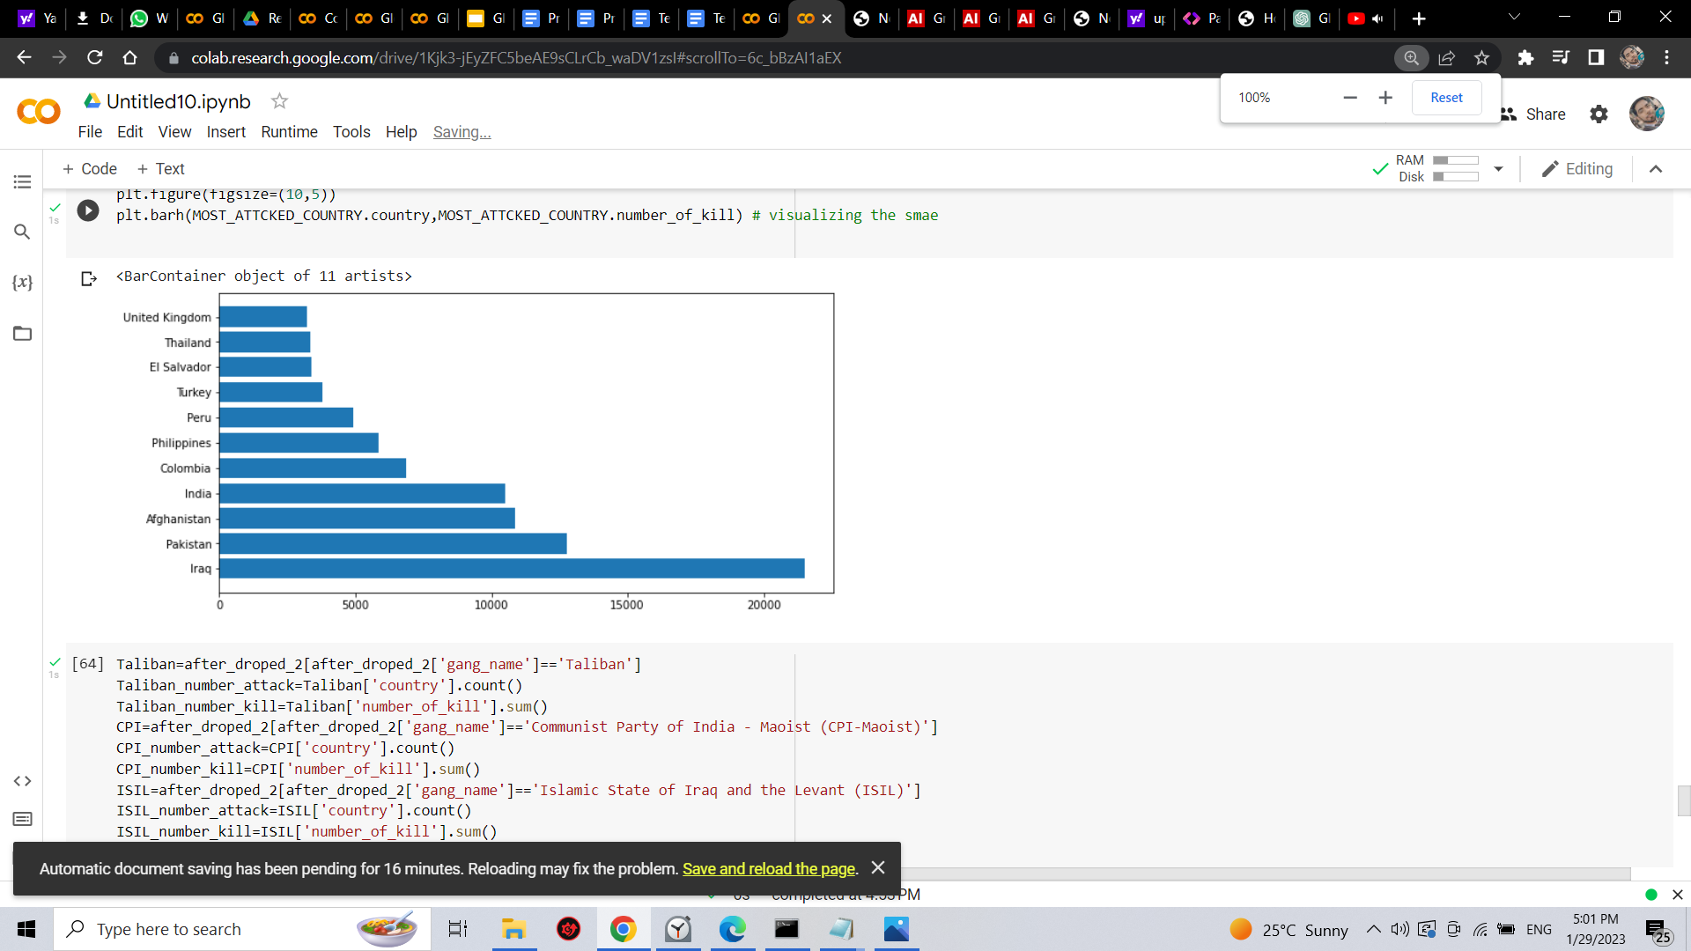
10 COUNTRIES WHICH ARE HAVING MOST NUMBER OF ATTACKS

Slide 14
CONCLUSION
:
Most attacks
Country with most attacks: Iraq
City with most attacks: Baghdad
Region with the most attacks: Middle East & North Africa
Year with the most attacks: 2014
Year with the most attacks: 2014
Group with the most attacks: Taliban
Most Attack Types: Bombing/Explosion
Map shows 4 location as per coordinates with most attacked country.
Basra
Mosul
Kirkuk
Baghdad
After ploting attacks with years.
Number of kills increased rapidly after 2010 and where 2014 being the most deadly year having maximum number of killing.
These three groups has been more contagious.
Unknown 95399.0(number of kills).
Islamic State of Iraq and the Levant (ISIL) 27174.0(number of kills).
Taliban 25785.0(number of kills).
Most killing in year.
Analysis tells that we have in the year 2001 most killing with 1340 lives.
Wounded were 8190 lives.
Al- Qaeda terrorist group involved and it was in Hijacking of Airlines.
Few Observation about Al-Qaeda.
Al-qaida group have done most killings.
Weapon used for killing is only two: 1)Explosives and 2)vehicle-borne explosive
Year 2001 more than 1 attack by Al- Qaeda.
Seems like USA and Al-Qaida were in war for some issue
Top active Terrorist group.
Most active gangs are Taliban,CPI-Maoist,ISIL.
These gangs are using mostly Bombing/Explosion and Armed Assault.
We can conclude that most attacks and most killings are performed by ISIL followed by Taiban.

Slide 15
THANK YOU
ADITYA RAJ
adityaraj7478444@gmail.com
8207478444

